Slide 1
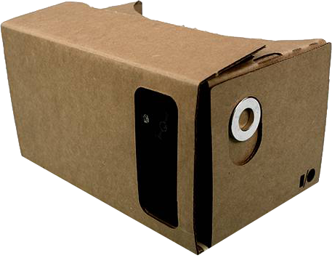
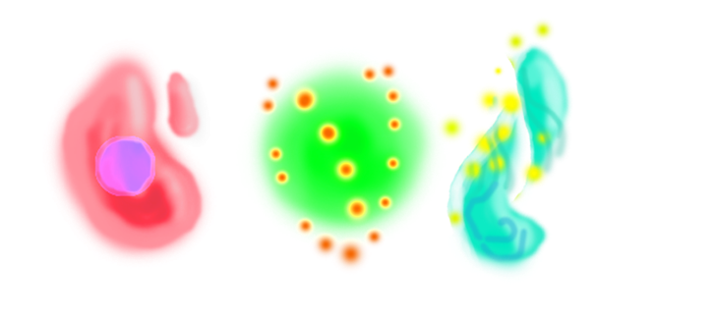
FLumin
Team “We are VR”

Slide 2
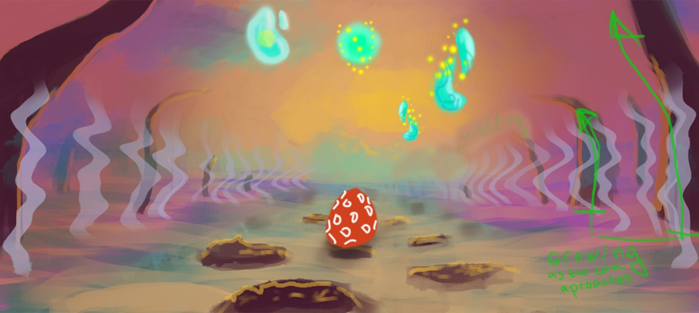
Original idea
Experience your favorite songs in a new way.
Jump in your music world, open your eyes and ears and let your emotions flow with the beats.

Slide 3
Making the design
How to make an immersive and personal visual experience based on a song?
What about scoring?
And player interaction?
Should it be only visual?
What about making it personal?

Slide 4
Giving it a gameplay
To give meaning we need choice, player choice:
In VR the player is the controller
Following a path, and creating your own experience as you fly around creates a bond with the music
Environmental feedback as visual reward based on the music rhythm

Slide 5
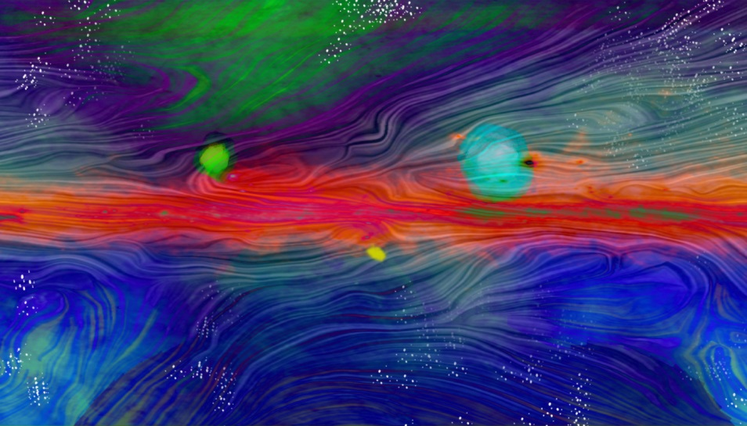
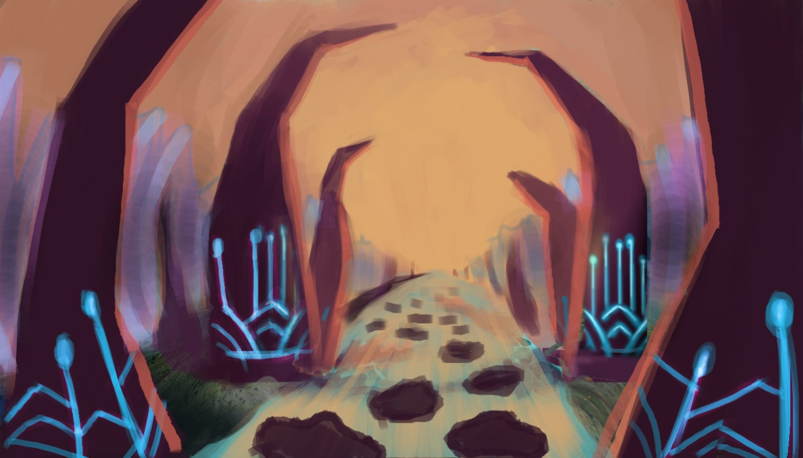
Original directions

Slide 6
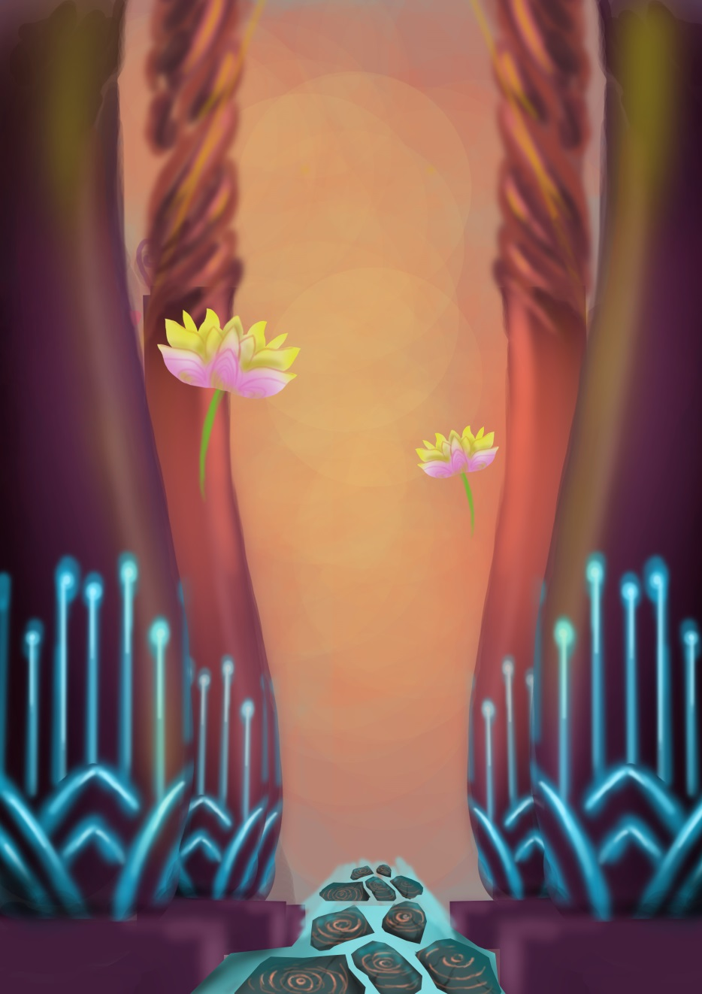
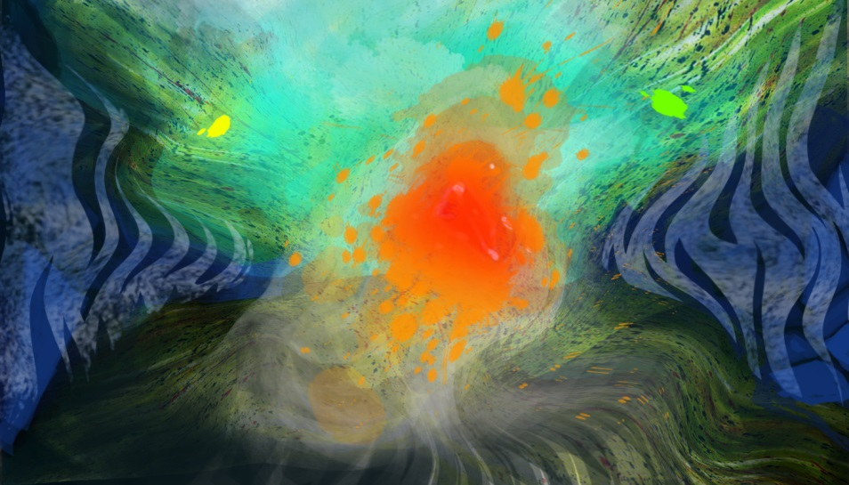
Original DirectionS

Slide 7
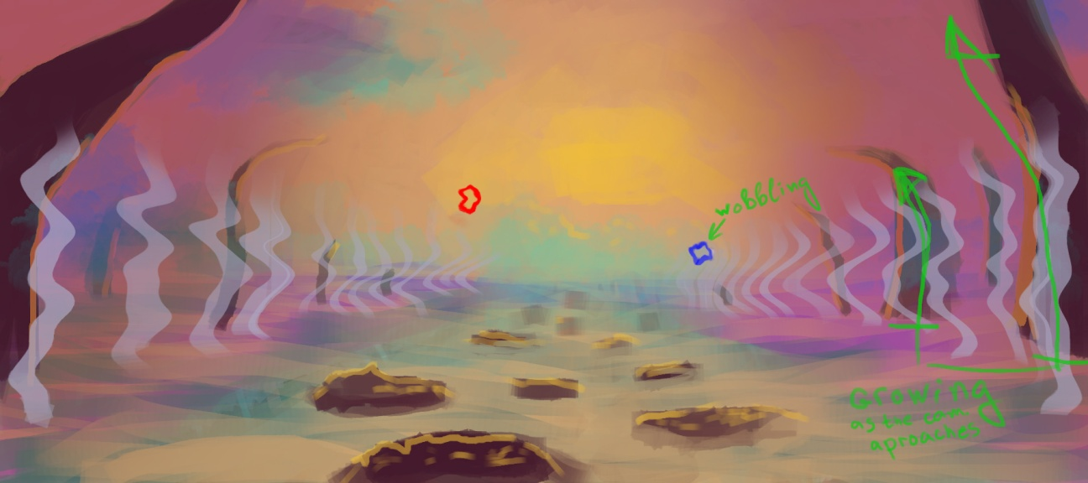
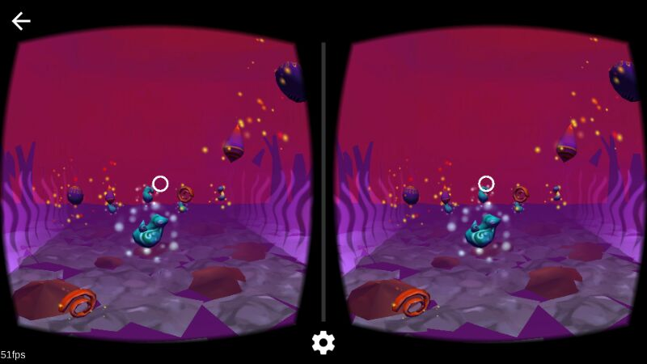
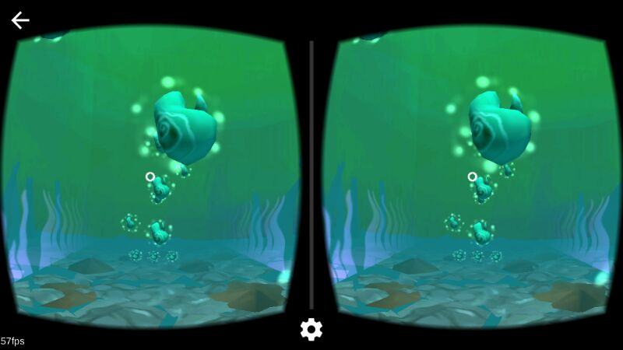
In the game
Choose your path at every beat
Collecting beads triggers a visual
Reward:
Scene color change
Wall bouncing
Particle explosion
Visual patterns bring variety to the
experience

Slide 8
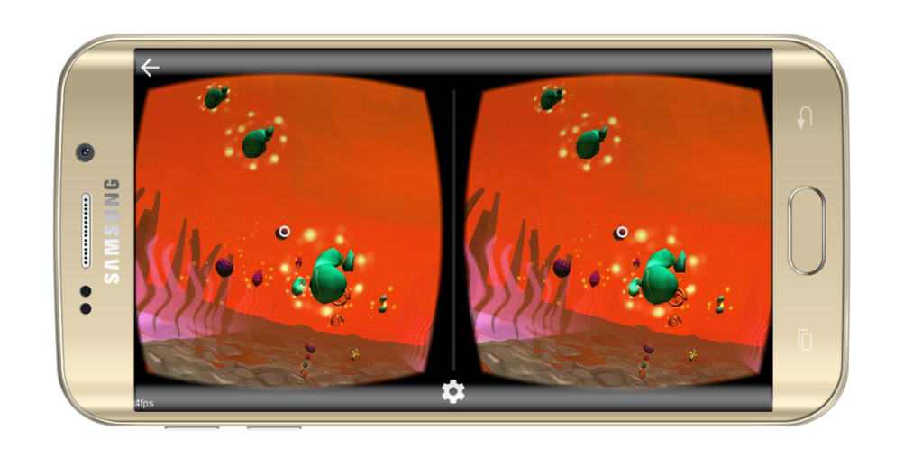
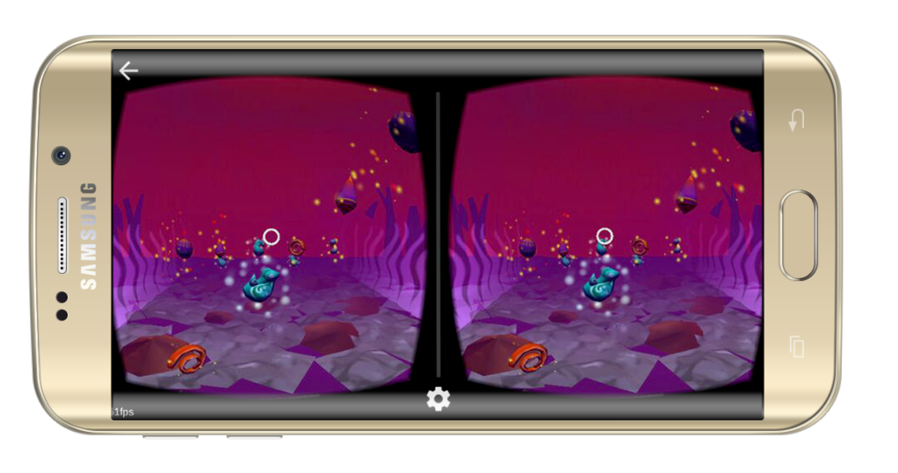
Available on your phone, Now!

Slide 9

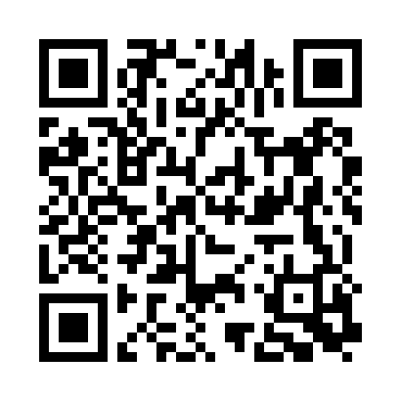

Get The game now

